Slide 1
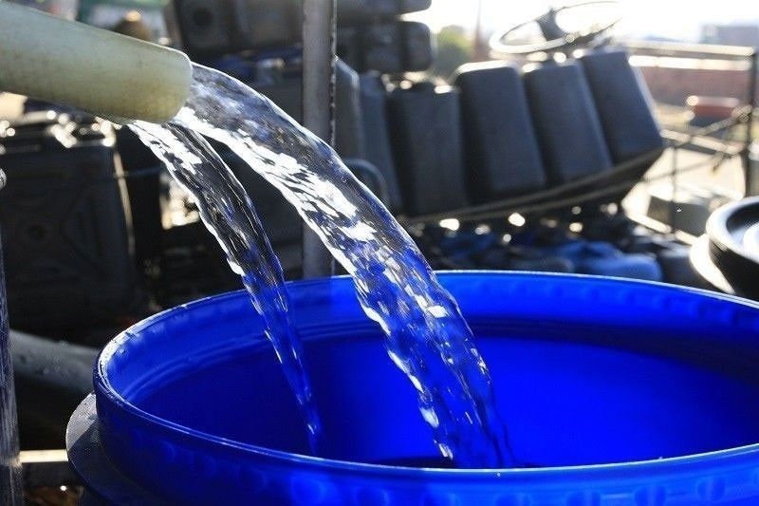
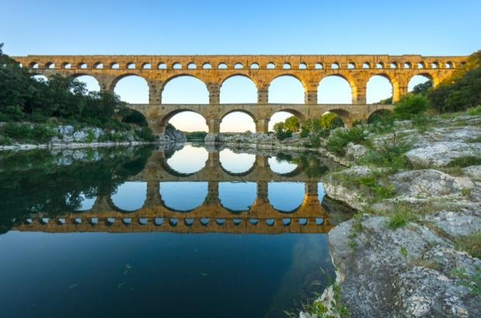


Introduction to Water Supply
Group Members:
Paras, 097
Parshuram, 098
Prabhakar, 099
Prabhat, 100
Prabindra, 101
Pradip, 102
Tutor:
Asst. Prof. Shukra Raj Paudel Department of Civil Engineering IOE, Tribhuvan University
2019-12-20

Slide 2
The Objective of this Presentation is to familiarize students about :
Importance and Types of Water
Historical development of water supply system
Objectives of water supply system
Schematic diagram of typical water supply system
Components of Water Supply System and their functions
2

Slide 3
Presentation Outline
Importance of water
Definition of Types of water
Historical development of water supply system
Water supply sector Institutions in Nepal
Objectives of Water Supply System
Schematic diagrams of Typical Water supply system
Components of Water Supply system and their functions
3

Slide 4
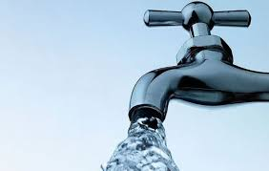
1.1 Importance of water
The five essential elements for existence of life on earth are: i) air ii) water iii) food iv) heat and iv) light
The functions of water in human body:
Carries nutrients to all cells in our body and oxygen to our brain
Allows the body to absorb and assimilate minerals, vitamins, amino acids, glucose and other substances
Helps in metabolism
Regulates the body temperature
Flushes out toxins and waste
https://english.ratopati.com
4

Slide 5
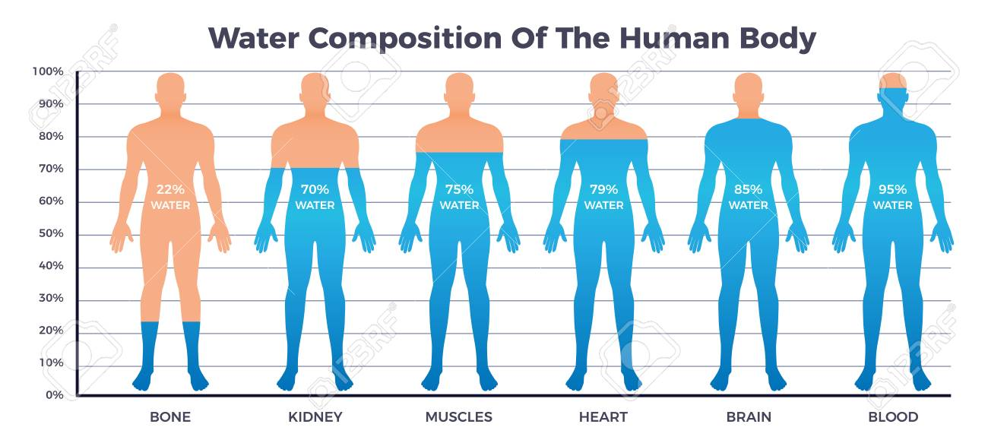
Fig: Composition of water on the body of human https://123rf.com
5

Slide 6

1.1.1 Effect of Decrease of water in human body
1% decrease makes man thirsty
5% decrease in water declines muscle strength and endurance significantly resulting in fatigue
10% loss causes delirium and blurred vision
20% reduction causes DEATH
Source:thestatesman.com
6

Slide 7

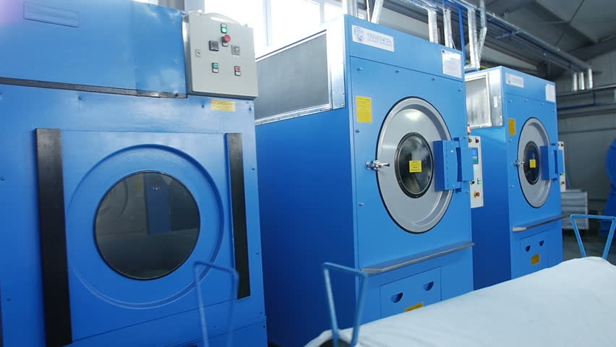
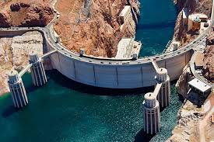
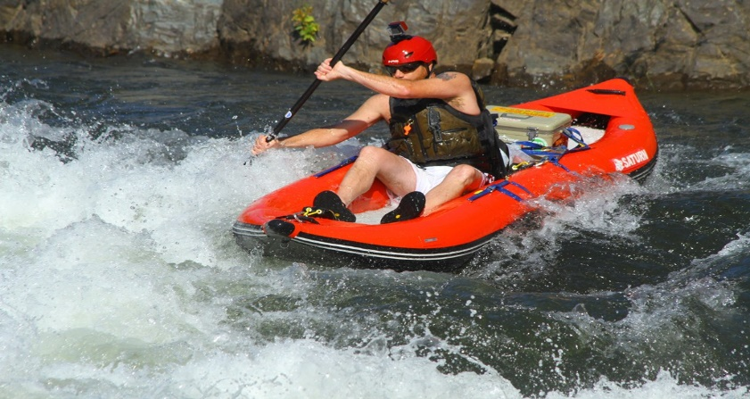
1.1.2 Uses of water
Household
Industrial
Power Generation
Recreational
7

Slide 8
Composition of water on Earth
71% of earth’s surface is covered by water
96.5% of this water is found in seas and oceans
1.7% of water is found as groundwater
1.7% in glaciers and the ice caps of Antarctica and Greenland
Only 2.5% of water is fresh water
98.8% of fresh water is found as ice and groundwater
Less than 0.3% of all freshwater is in rivers, lakes and groundwater
8

Slide 9
Distribution of water on the surface of earth

Slide 10
2.0 Classification of water
Pure and impure water
WATER
Potable and wholeso me water
Polluted and contami nated water

Slide 11
2.1 Pure and impure water
The water that is two parts hydrogen and one part oxygen free from any impurity and minerals is known as pure water
The water that contain substances other than hydrogen and oxygen such as salts and organic matter is known as impure water
Pure water is not considered optimal for human consumption as it lacks vital minerals
Pure water is obtained in the laboratory by the process of distillation. Distilled water is only used for experimental purposes, and in hospitals
11

Slide 12
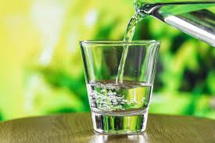

2.2 Potable and wholesome water
Potable water is defined as the water which is safe for consumption for humans as well as animals
Also known as safe water
Potable water, in other words can be regarded as the water containing the minimum requirements for drinkability
Fig: potable water
Source: https://www.connexionfrance.com
Water may be potable naturally or it may need to be treated in order to be safe
12

Slide 13
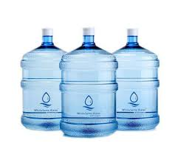
Wholesome Water
Usable and pleasant water that is free from pathogens and harmful chemicals is known as wholesome water.
Source:https://www.roestore.pk
13

Slide 14
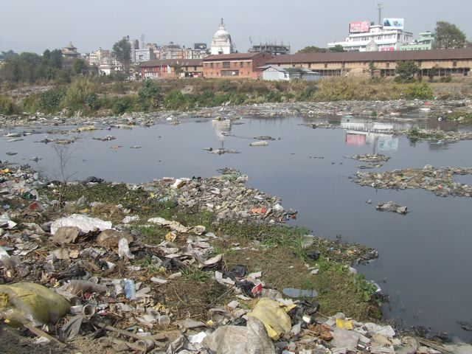
2.3 Polluted and contaminated water
• Water that contains excessive impurities such as minerals, salts, gasses etc. is polluted water
• Polluted water contains mainly inorganic wastes released from industries and homes
• The water that contains the microorganisms such as bacteria, virus, protozoa and worms is called contaminated water
Source: en.reportersnepal.com
14

Slide 15
Some Interesting Facts
About 25740 liters of water is required to grow a day’s food for a family of four.
In just one day, 200 million work hours are consumed by women collecting water for their families.
$260 billion is the estimated annual economic loss from poor water and sanitation in developing countries.
The length of the side of a cube which could hold the Earth’s estimated total volume of water in km = 1150.
15

Slide 16
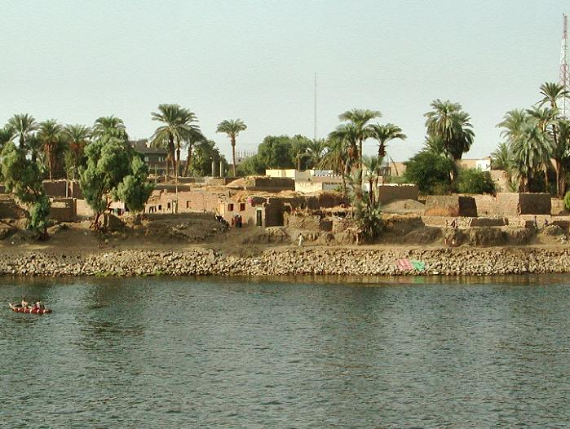
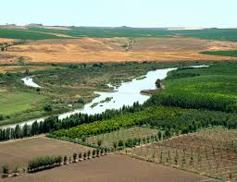
3.0 Historical development of water supply system
Water is a vital resource necessary for surviving. It also contributes to human health, irrigation and transportation. The early human civilization were thus developed near water sources.
Fig. Ancient Civilizations near Water Sources
Source: historygeek.org
16

Slide 17
As population increased, the water demand increased drastically.
The water source also became gradually polluted due to discharge of large amount of waste into sources.
Water supply system was developed with the objective to supply potable water free from pollution to the consumers.
It also made water collection easy for communities far from source.
17

Slide 18
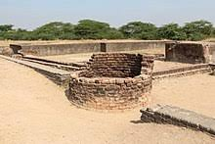
The digging of shallow wells was probably the earliest innovations in water resource development beyond natural sources like lake, river, etc.
As need increased, wells were made deeper.
Fig. Brick lined wells in Indus river basin
Source: historygeek.org
18

Slide 19
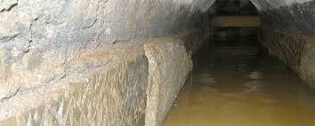
As community grew larger, channel water supply also developed gradually.
Fig. Aqueducts built throughout the roman empires
Source: medium.com/aqueduct-history
19

Slide 20
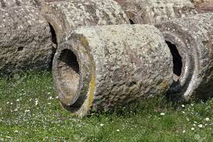
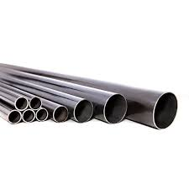
Channels were constructed of cut stone, rough concrete or brick. Pipes were typically made of drilled stone.
Cast iron pipes were not used much until 19th century.
Fig: Drilled stone pipe Fig: Cast iron pipe
Source: pipeworks.com/history
20

Slide 21
3.1 Water supply system in Nepal
People relied on groundwater, wells, natural steams for centuries before Nepal’s exposure to western world.
Stone spouts were the first systematic attempt to deliver clean drinking water distant from the source.
Stone spouts were introduced to Kathmandu valley in the 5th to 7th centuries.
21

Slide 22
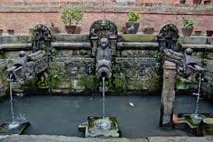
Mangaldhara of Patan is the oldest stone spout in the valley.
Fig. Stone spout in Patan
Source: ratopati.com
22

Slide 23
Piped water supply system was developed in Nepal after 1895 A.D.
During this period, first Bir Dhara system and also pani Goshwara Adda was established which provided pipe supply of water to limited community.
Later on, water service was extended gradually to other districts also like Kavre, Palpa, Biratnagar, etc.
23

Slide 24
Along with the pollution and pollutants, water gradually became infavourable for drinking without purification.
During 1980s large no. of people were infected with water borne disease.
The supply of potable water has been challenging work to water authorities of Nepal
24

Slide 25
3.2 Progressive status of water supply in Nepal
Prior to the year 2005, Nepal has following the drinking water quality standard set by world health organization.
Nepal’s own drinking water quality standard called national drinking water quality standard (NDWQS) of Nepal came into effective in 2005.
Department of water supply and sewerage(DWSS) were formally established in 1972 to provide lead inputs in the development of water supply and sanitation programs throughout Nepal.
25

Slide 26
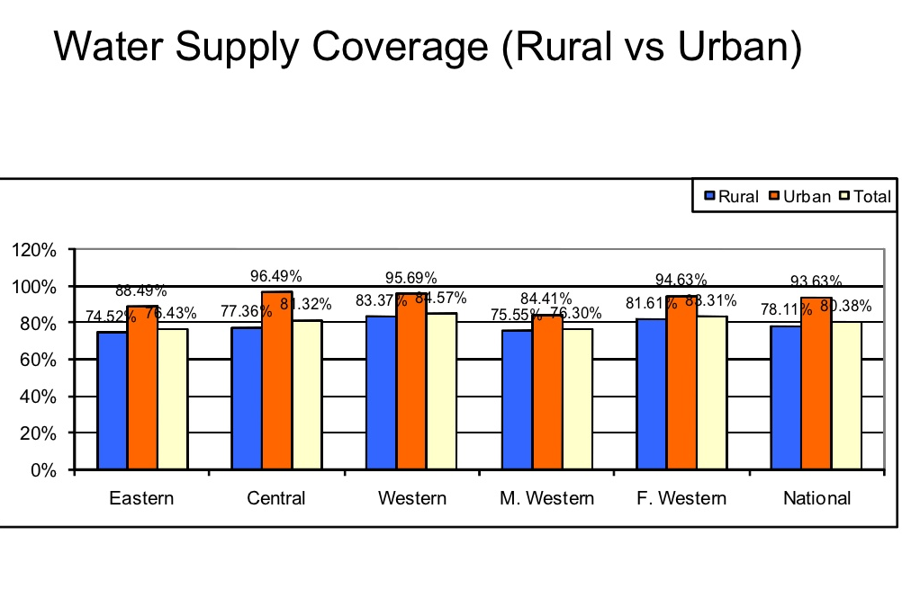
At present, DWSS is providing a nationwide service through its 5 regional, 42 divisional and 28 sub divisional offices throughout the country.
Source:
moewri.gov.np
Fig. Rural v/s Urban Water Supply Coverage (2011)
26

Slide 27
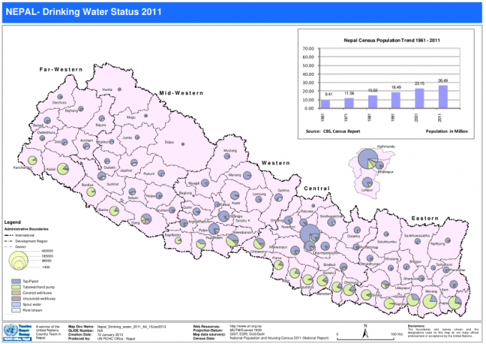
Source:
moewri.gov.np
Fig. Drinking Water Status (2011)
27

Slide 28
4.0 Water Supply Sector Institutions In Nepal
Ministries
NGO’s
Local
Govt.
Govt. Departments
Govt. Bodies
Others
Water Supply Institutions
28

Slide 29
Water supply sector in Nepal is controlled and mobilized by various institutions ranging in hierarchy from top level to local level
Ministries are the highest level institutions responsible for
Policy formation
Planning and Budgeting
Implementation
Operation and maintenance
Monitoring and evaluation at central level
In the local level, these works are carried out by
Local Governments
Community Groups
NGO’s and public committees
29

Slide 30
The table below lists the institutions involved in various levels
Ministries | Urban Development (MoUD) Local Development (MLD) Water Development (MWR) Education and Sports (MoES) Health and population (MoHP)
Government Departments | Department for Water Supply and Sewerage (DWSS) Department of Urban Development & Building Construction (DUDBC) Department of Local Infrastructure Development and Agricultural Roads (DoLIDAR)
Government Bodies | Water Supply Tariff Fixation Committee (WSTFC) Town Development Fund (TDF) Nepal Water Development Corporation (NWDC) Kathmandu Upatyaka Khanepani Limited (KUKL)
Continued..
30

Slide 31
Local Government | District Development Committee (DDC) Municipalities Village Development Committee(VDC)
NGOs | Nepal water For Health (NEWAH) Water Aid Nepal Environment And Public Health Organization (ENPHO) Federation of Drinking Water and Sanitation Users Nepal (FEDWASUN)
Others | Urban Development Through Local Efforts Public-Private Partnership For Urban Development UN-Habitat Nepal World Health Organization (WHO) Etc.
31

Slide 32
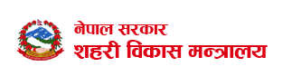
4.1 Brief Overview of Ministries and other institutions involved in water supply
Ministry Of Urban Development (MOUD)
It performs overall responsibilities for water supply promotion
It actively formulates various policies regarding proper water supply in major urban areas
It also employs various strategies and projects to deal with existing water supply challenges in urban development
Source: www.moud.gov.np
32

Slide 33
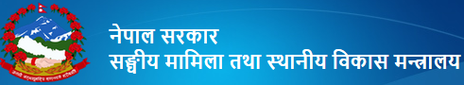
2) Ministry of Federal Affairs and Local Development (MOFALD)
It is the lead government body for promoting local development and decentralization
It achieves it’s objectives through local bodies such as the DDC, the municipality and the VDC
Under this ministry, DOLIDAR conducts various small scale rural development activities like water supply schemes
Source: www.mofald.gov.np
33

Slide 34
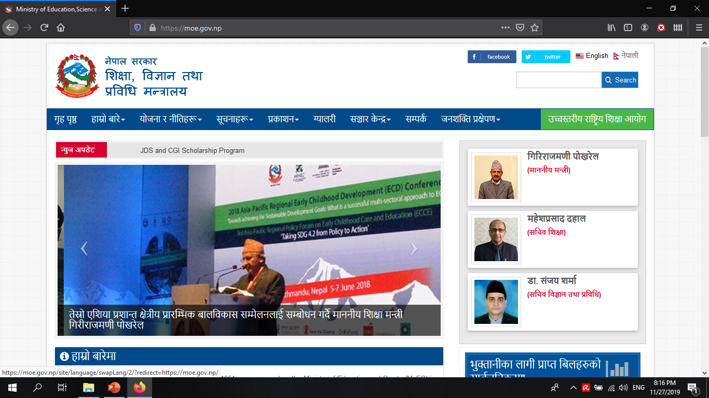
3) Ministry of Education, Science and Technology (MoEST)
Source: www.moe.gov.np
Formerly known as Ministry of Education and Sports (MOES), it is the lead government body responsible for overall development of education in the country
The physical service section in the department designs and constructs basic school infrastructure including water supply and sanitation facilities
The school water supply schemes are contracted at district level under supervision of District Education Office’s chief engineer
34

Slide 35
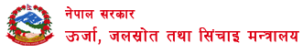
4) Ministry of Energy, Water Resources and Irrigation (MoEWRI)
Source: www.moewri.gov.np
It was formerly called Ministry of Water Resources
It is responsible for implementation of water resource policies
It has no direct involvement in water supply sector other than licensing and registering water user associations through district water resources committees
35

Slide 36
5) Water Tariff Fixation Commission (WTFC)
WTFC was formed in 2007
It’s main purpose is fixing the tariff of water supply and sanitation service
WTFC was formed for the protection of the interests of consumers by providing qualitative and reliable water supply
6)Nepal Water Supply Corporation (NWSC)
It is responsible for provision of drinking water in designated municipalities
Transformed into Kathmandu Valley Water Supply Management Board in 2008
It is managed by Kathmandu Upatyaka Khanipani Limited (KUKL)
36

Slide 37
7) Rural Water Supply and Sanitation Fund Development Board
It implements a national program addressing the needs of many small and medium sized rural villages
8)Department of Water Supply and sewerage (DWSS)
It has 5 regional, 42 divisional and 28 sub divisional offices in 75 districts
It implements water supply and sanitation projects together in coordination with local government
37

Slide 38
1.5 Objectives of water supply system
To supply safe, wholesome and potable water to the consumers
To supply water in adequate quantity
To make water easily available to the consumers
To supply water to the domesticated animals
To supply water to the industries, commercial
establishment
To save time in fetching water
38

Slide 39
1.6 Schematic diagram of typical water supply system
Schematic diagram is the diagram showing the layout of water supply system and its components, system of supply extending from the source to the consumers areas
The water supply system of urban and rural areas may be different depending upon the topography, type of water supply, requirements of the consumers so schematic diagram of supply in rural and urban areas are different
39

Slide 40
Schematic diagram for urban water supply system
The main components of the system are:
❖ Collection system of intake and pump
❖ Transmission main
❖ Treatment plant
❖ Reservoir and distribution system
40

Slide 41
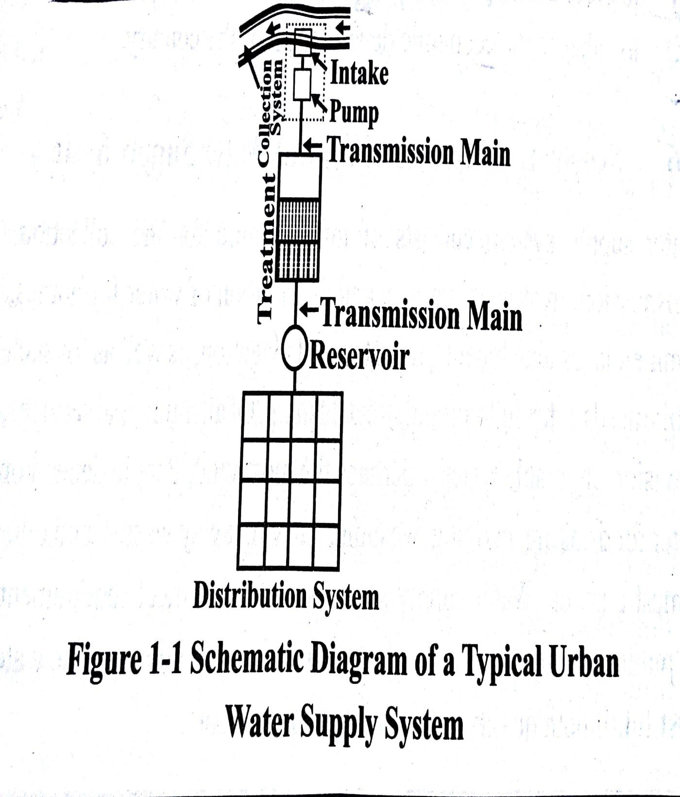
Source: water supply engineering, Bhagwan Ratna kansakar
41

Slide 42
Schematic diagram for the rural water supply system
The population density in the rural areas is low so the water is supplied through the public stand posts(PSP)
The supply system in the rural areas have vast
differences from that of urban areas due to topography
In rural areas either spring or stream are used as source which may or may not require treatment but generally treatment is not done
The supply system is similar to that of the hilly region but in terai region the source of water In the terai region is dug well or tube well
42

Slide 43
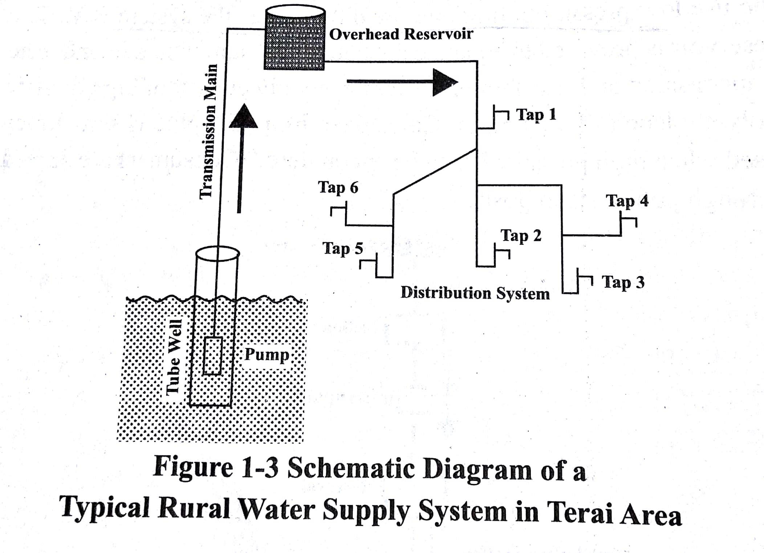
Source: water supply engineering, Bhagwan Ratna kansakar
43

Slide 44
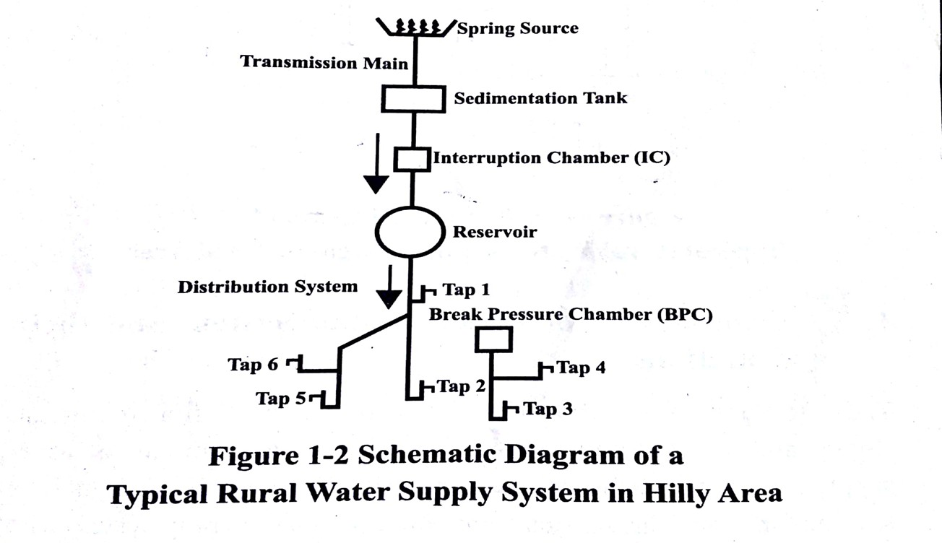
Source: water supply engineering, Bhagwan Ratna kansakar
44

Slide 45
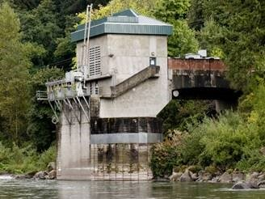
1.7 Components of water supply system
a) Intake
It is a structure or device constructed at the water source for the purpose of drawing water from the source
Fig: intake
Intake mainly comprises of screen
at open end to screen out large and floating materials, conduit to
convey the water from the source, valves to regulate flow
45

Slide 46
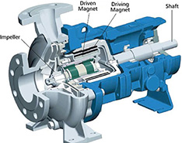
b)Pump
It is intake
a machine
placed at the the water from
site to lift
the source
It supplies
the required power to
transfer energy level
water
from the lower
level to
the higher energy
Fig: pump
https://pumpandsystems.com
The pumping of water should be avoided as much as possible in order to reduce the cost of the project
46

Slide 47
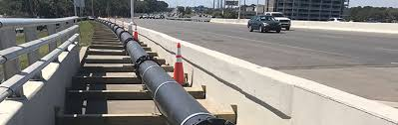
c) Transmission main
It is the conduit or pipe laid to convey the water from the source to the service reservoir
It is designed for the flow equivalent to the maximum daily demand
In Nepal, transmission main and all other components are designed by assuming peak factor as 1
Source:https://www.dewberry.com
47

Slide 48
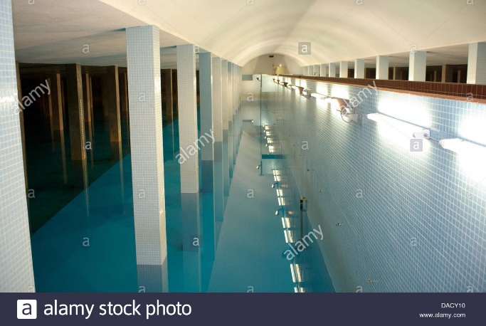
d) Collection Chamber (CC)
It is provided near to the intake site to collect the water from one or more sources
It also breaks the incoming water pressure into the atmospheric pressure forming a new water level
https://www.alarmy.com
Fig: collection chamber
It also prevents the backflow of water from one source to the other
48

Slide 49
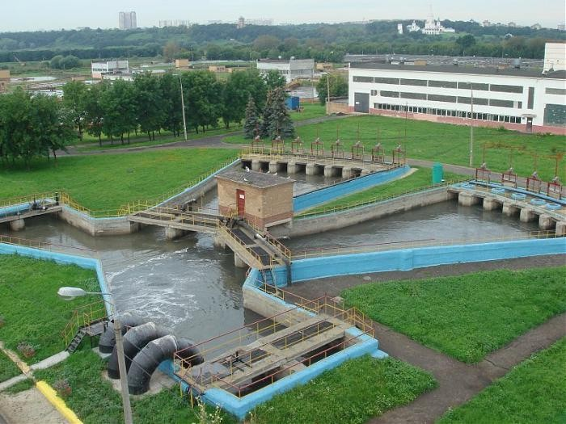
e) Distribution chamber
It is the chamber provided at a junction in the pipeline when water has to be conveyed into more than one direction at atmospheric pressure
Fig: Distribution chamber
https://www.wikipedia.org
49

Slide 50
f) Interruption Chamber
It is a chamber or tank located in the transmission main to break the excessive internal water pressure
High pressure is not beneficial as it tend to break the pipe
The provision of the interruption chamber at strategic location will avoid the necessity of high pressure rating pipes and optimizes cost
50

Slide 51
g) Water treatment works
Water containing excessive amount of impurities is not suitable to drink
Water treatment works are provided in the water supply system to remove these impurities and make the water safe
The various water treatment methods that can be provided are:
Screening
Sedimentation
Filtration, disinfection, aeration etc.
51

Slide 52
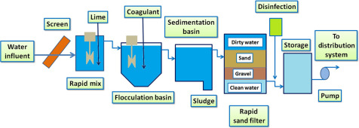
https://www.sciencedirect.com
Schematic Diagram of a Water Treatment Plant
52

Slide 53
h) Reservoir
It is used to store water
Depending upon the purpose of use, the reservoir may be:
Service reservoir
Clear water reservoir
Clear water reservoir is provided at the treatment site to
store treated water
Service reservoir equalizes the hourly demand fluctuations and stores the water for the break down reserve and fire fighting purpose
53

Slide 54
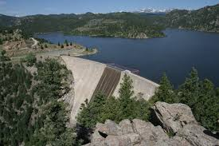
https://www.britannica.com
Fig: Reservoir
54

Slide 55
i) Distribution system
Distribution system is a network of pipeline to convey the water from the service reservoir to the consumer premises
It is designed for maximum or peak flow
The pipelines in the distribution system are classified as main, sub-mains, branches and laterals.
The layout of the distribution system can be in the form of branched system, looped system or combination of branched and looped systems.
55

Slide 56
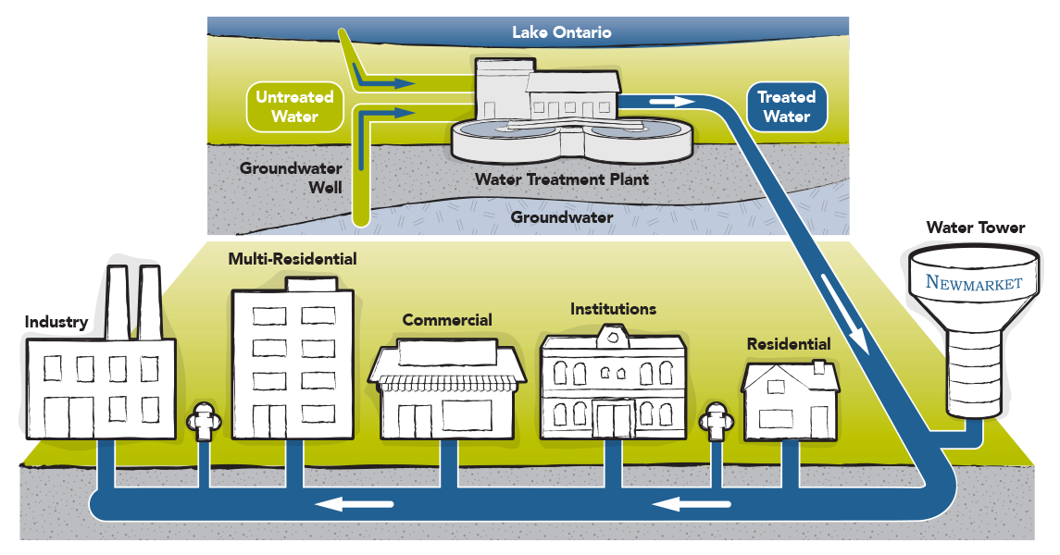
https://www.newmarket.ca
Fig: Water Distribution System
56

Slide 57
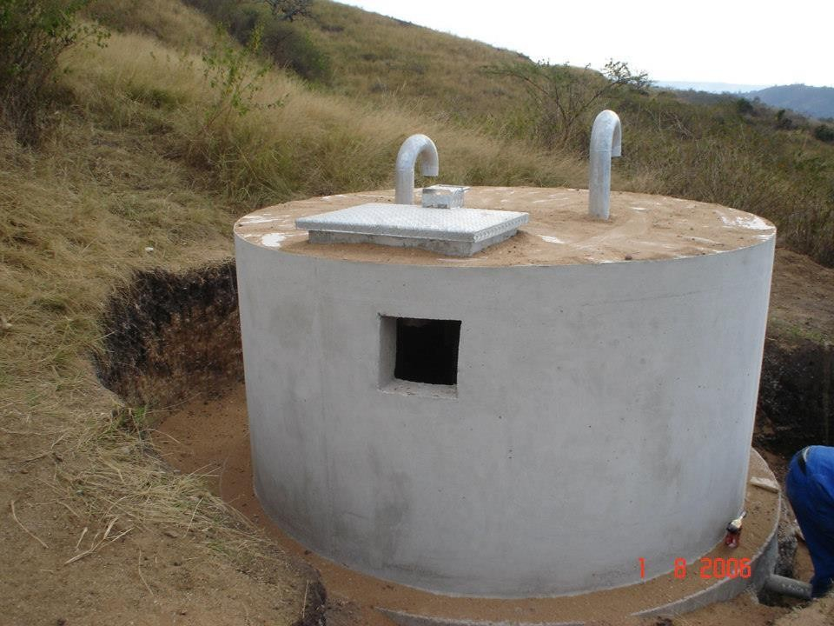
j) Break pressure chamber
Break pressure chamber is a chamber or tank located in the distribution system to break the excessive internal water pressure built In the pipeline
https://www.britannica.com
Fig: Break pressure tank
57

Slide 58
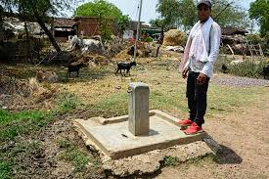
k) Public stand posts
It is a structure in the pipeline from where water is distributed to the consumers
It is used in areas where private
household connection is not feasible
It is also provided in the urban water supply system where the people cannot afford the private household connection
Fig: public stand post
https://www.flickr.com
58

Slide 59
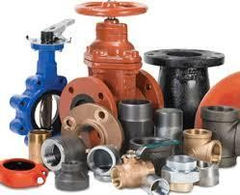
l) Valves and fittings
Valves are the accessories provided in the pipeline to regulate and control the flow
Valve chamber is a location where more than one valves are located
The fittings are used in the water supply system for its proper functioning and utilization.
Some of the commonly used fittings include bends, reducers, crosses, angles,etc.
https://www.britannica.com
59

Slide 60
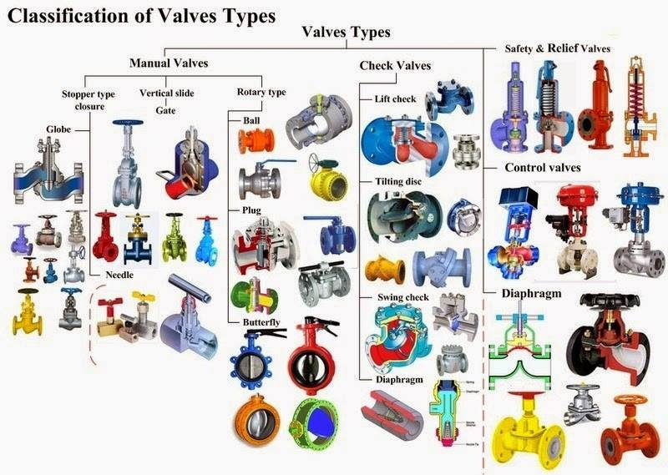
https://www.automationforum.in
60

Slide 61
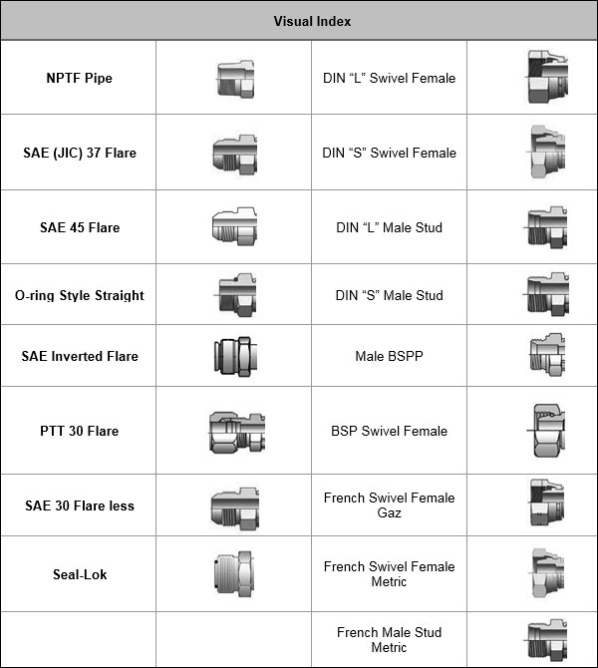
Fig: Some Hydraulic Hose Fittings
https://www.blog.parker.com
61

Slide 62
THANK YOU

